Slide 1
Participation Tools Workstream
End of PI-27 Report

Slide 2
Workstream Update
Workstream Name: | Participation Tools
Roadmap Pillar: | Pillar 1: Make adoption easier
Lead: | James Bush
Workstream Objectives: | Foster a vibrant and diverse set of open-source participation tools which remove or reduce barriers to DFSP participation in Mojaloop schemes. Gather and document stakeholder requirements, for participation tools. Coordinate community contributions to deliver solutions which meet stakeholder requirements.
Progress Against Objectives: | Improved guidance documentation published MCM refactoring and adoption PM4ML adoption
Roadblocks: | Resource limitations: Committed resources from community and adopters.
Support Needed: | Product input from community members, adopters, DFSPs & System Integrators (both technical and business focused input) Software engineering contributions to work on SDK, PHEE etc…

Slide 3
Progress Since Last Report
Improved guidance documentation published
https://docs.mojaloop.io/product/features/connectivity.html
Participant onboarding journey improvements
MCM refactoring to enable more flexible deployment and usage.
Deployment not dependant on IaC
Simple HELM deploys now also supported.
Security model reworked to support flexible standards compliant IAM e.g. OIDC
Enabling “local” dev testing of integrations against MCM and core-test-harness
Codebase adoption to MLF stewardship
Complete adoption of PM4ML
Good progress made but some tasks outstanding
Docker compose version of PM4ML released

Slide 4
Objectives for PI-28
Refactored MCM release
Complete adoption of PM4ML codebase
Better packaging of solutions around overall workstream high-level objectives.
More “Shrink wrapped” deployment of participation tools.
Better categorisation/indexing/organisation of repos to guide integrators towards participation tools.

Slide 5
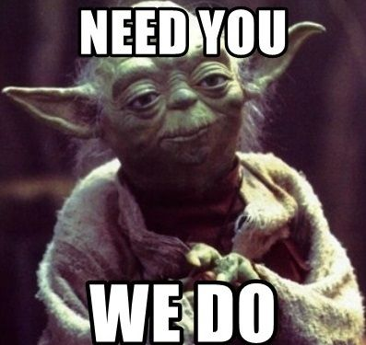
Joining the workstream
Mojaloop Slack: #ws-participation-tools
Weekly meeting (zoom) on Wednesdays @ 0800 UTC

